Slide 1
Advanced Skills in EAGLE (Intermediate)
Day 2: Soldering

Slide 2

Safety Precautions

Slide 3
Outline
Milling the circuit on PCB
Equipment
Introduction to soldering
Soldering SMD
Soldering Through Hole

Slide 4
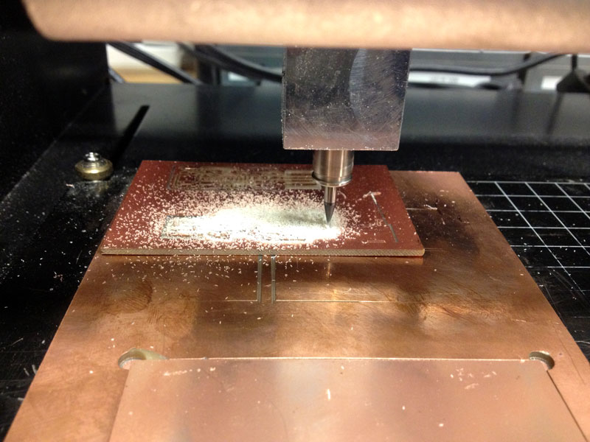
How to do the milling
Roland Modela MDx-20
CNC machine

Slide 5
The milling of the PCB
Export as PNG
Use the fabmodules tool
http://fabmodules.org/
Generate the tool path and the .rml file

Slide 6
LET’S DO IT NOW
The MILLING

Slide 7
The tools
Soldering iron
Solder wire
Solder removers
Cutter
Tweezers
Magnifying lens
Multimeter

Slide 8
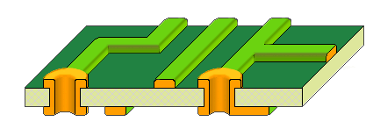
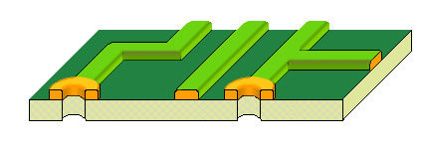
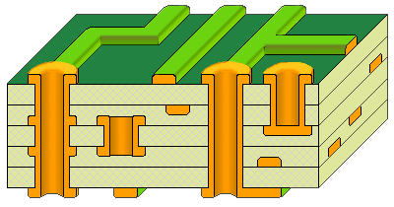
Kinds of PCBs
Single sided (only TH or only SMD)
Double sided (both TH & SMD)
Multi-layered (both TH & SMD)

Slide 9
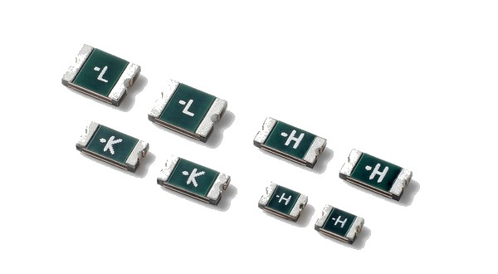
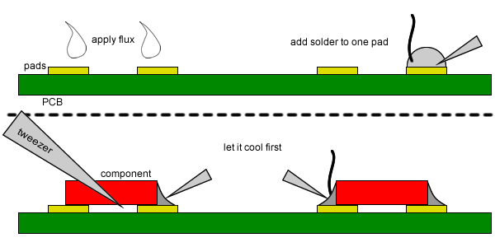
Soldering SMD
SMD = surface mount device
Small (less area)
Has no pins (leads)

Slide 10
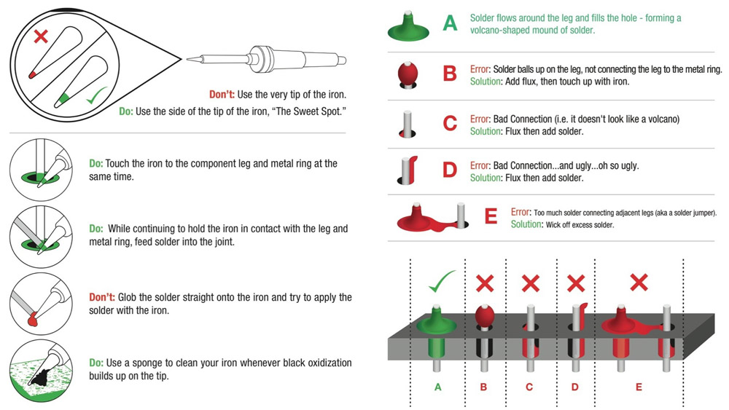
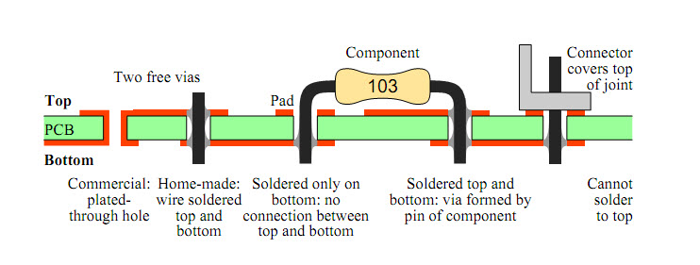
Soldering TH
TH = through hole
Larger than SMD
Has leads that passes through holes in the pcb

Slide 11
Soldering TH

Slide 12
LET’S DO IT NOW
The SOLDERING

Slide 13
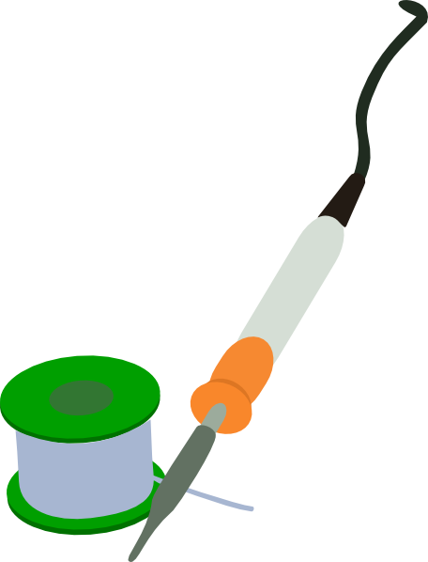
ANY QUESTIONS??

Slide 14
My Contact Information
Name: Mosab Wadea
E-mail: mwaamh+fl@gmail.com

